Slide 1
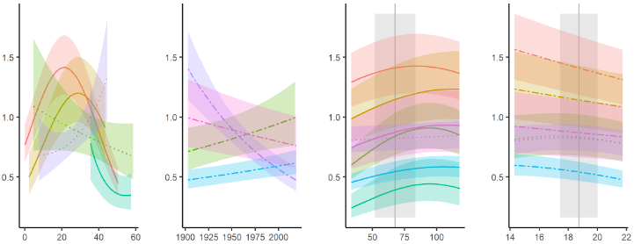
Step 1: Identify primary climate drivers
Water group
Temperature group
RW (mm)
climate variables (monthly)
Precipitation (PPT)
Precip day frequency (PDF)*
Streamflow (SF)*
T_{mean}
T_{min}
T_{max}
PET *
residuals
*some sites only
y
x
Climwin
run by site, separately for water and temperature groups
core and species random effects
variables and seasonal windows selected to minimize AIC
Step 2: Combine primary climate drivers, DBH, and year in GLS model
2 climate drivers: objectively selected from water and temperature groups, along with seasonal window
DBH (reconstructed over tree’s lifespan)
year
RW (mm)
driver variables
y
x
GLS model
run by species (separately for each site)
tree random effect
autocorrelation structure to account for stochasticity of individual growth trends
RW (mm)
DBH (cm)
year
PPT p.Jun-c.Jul (mm mo⁻¹)
T_{max} p.Aug (°C)

Slide 2


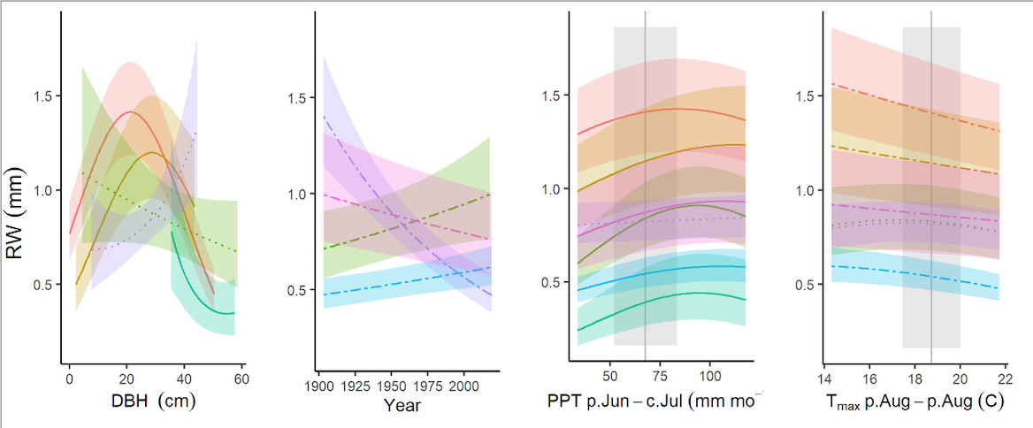
Step 1: Identify most significant climate drivers
candidate climate drivers (monthly)
Temperature group
Water group
spline-detrended growth (RW, BAI, or ∆AGB)
T_{mean}
T_{min}
T_{max}
Potential Evapotranspiration (PET)*
Precipitation (PPT)
Precip day frequency (PDF)*
Streamflow (SF)*
RW (mm)
x
* not available for all sites
y: residuals
climwin
AIC
top climate drivers:
top driver in each group,
optimal time windows
Step 2: Combine DBH and climate drivers in GLS model
2 independent, objectively selected top climate drivers
reconstructed DBH
year
x
GLS model
species random effect
autocorrelation structure to account for stochasticity of individual growth trends
driver variables
(plot w/o spline)
y
Notes:
Example is POTR_NA_CedarBreaks.21-0301A

Slide 3

Step 1: Identify most significant climate drivers
candidate climate drivers (CRU monthly)
spline-detrended ∆r or ∆AGB
T GROUP
PPT GROUP
CLOUD GROUP
mean T
min T
max T
PET*
daily T range
% cloud cover
PET*
∆r
precipitation
n precip days
x
y: residuals
climwin
AIC
top climate drivers:
top driver in each of 3 groups,
optimal time windows
remove any redundancy w.r.t. PET(*) or collinearity
Step 2: Combine DBH, climate, and environmental drivers in GLS model
2-3 independent top climate drivers
reconstructed DBH
atmospheric pollution
GLS model
species random effect
simultaneous detrending with spline on year (by individual)
driver variables
CO₂ SO₂ NO_{x}
x
∆r
(plot w/o spline)
y

